Slide 1

Visual Story
IT’S A STRING THING
An in-school experience in your library, classroom or gym.
What to expect at It’s a String Thing, a visual story for children.

Slide 2
What’s in this guide?
This visual story will guide you through It’s a String Thing, an in-school performance by Patch Theatre.
We have detailed the experience and noted tactile, audio and visual details for those with sensory sensitivities.
You can read through this guide before our visit so you can get to know the show and let children know what to expect.
Information is subject to change. Please check our website for the latest details.
For more information, please contact Patch Theatre:
Website: www.patchtheatre.org.au
Email: patch@patchtheatre.org.au
Phone: (08) 8470 0165
Show warnings: None
Venue accessibility: please see your school’s accessibility guidance.
Show photography by Andrew Beveridge.
This guide was created by Patch Theatre (2026).
Version 1.00 042026

Slide 3
Bringing the theatre to your school
It’s a String Thing is an in-school experience. We come to a dedicated space in your school to allow children to experience performance in a familiar environment.
We warmly welcome people with access needs or sensory sensitivities to our shows.
It’s a String Thing invites children to explore, imagine and engage in their own way. It is interactive, tactile and free flowing. We encourage the opportunity for children to interact and get involved in the story telling process.
Children will be asked to follow instructions throughout the story. A child does not have to participate or follow instructions if they choose not to.
Children are invited to touch and pass around a ‘string’ made of different materials with different sensations and textures. They will be asked to interact with the string and move around from sitting to standing to lying.
Depending on group size and/or access needs, educators can sit amongst the children to help movement and facilitate the passing of the string.
We encourage you to enhance the performance flow and share our relaxed approach to noise and movement. We love to see children react and feel in the moment.
The performer will bring children’s suggestions into the story and allow space for their natural reactions — comments, wriggles, expressive arms and more.
If the performer feels they need additional support to gently guide attention back to the performance, they will indicate this to you during the session.
Here are some other good things to know:
  The performance will take place in the nominated space in your school. There will be no adjustments to lighting or use of projected sound in that space.
  We take a relaxed approach to audience noise and movement, and children who need a break are welcome to exit and re-enter the experience with guidance from a teacher or member of staff.
  We recommend bringing sensory equipment for children who may find the show over-stimulating.

Slide 4
Visual Story
IT’S A STRING THING
A guide for children about what
they will touch, see, hear and do.

Slide 5
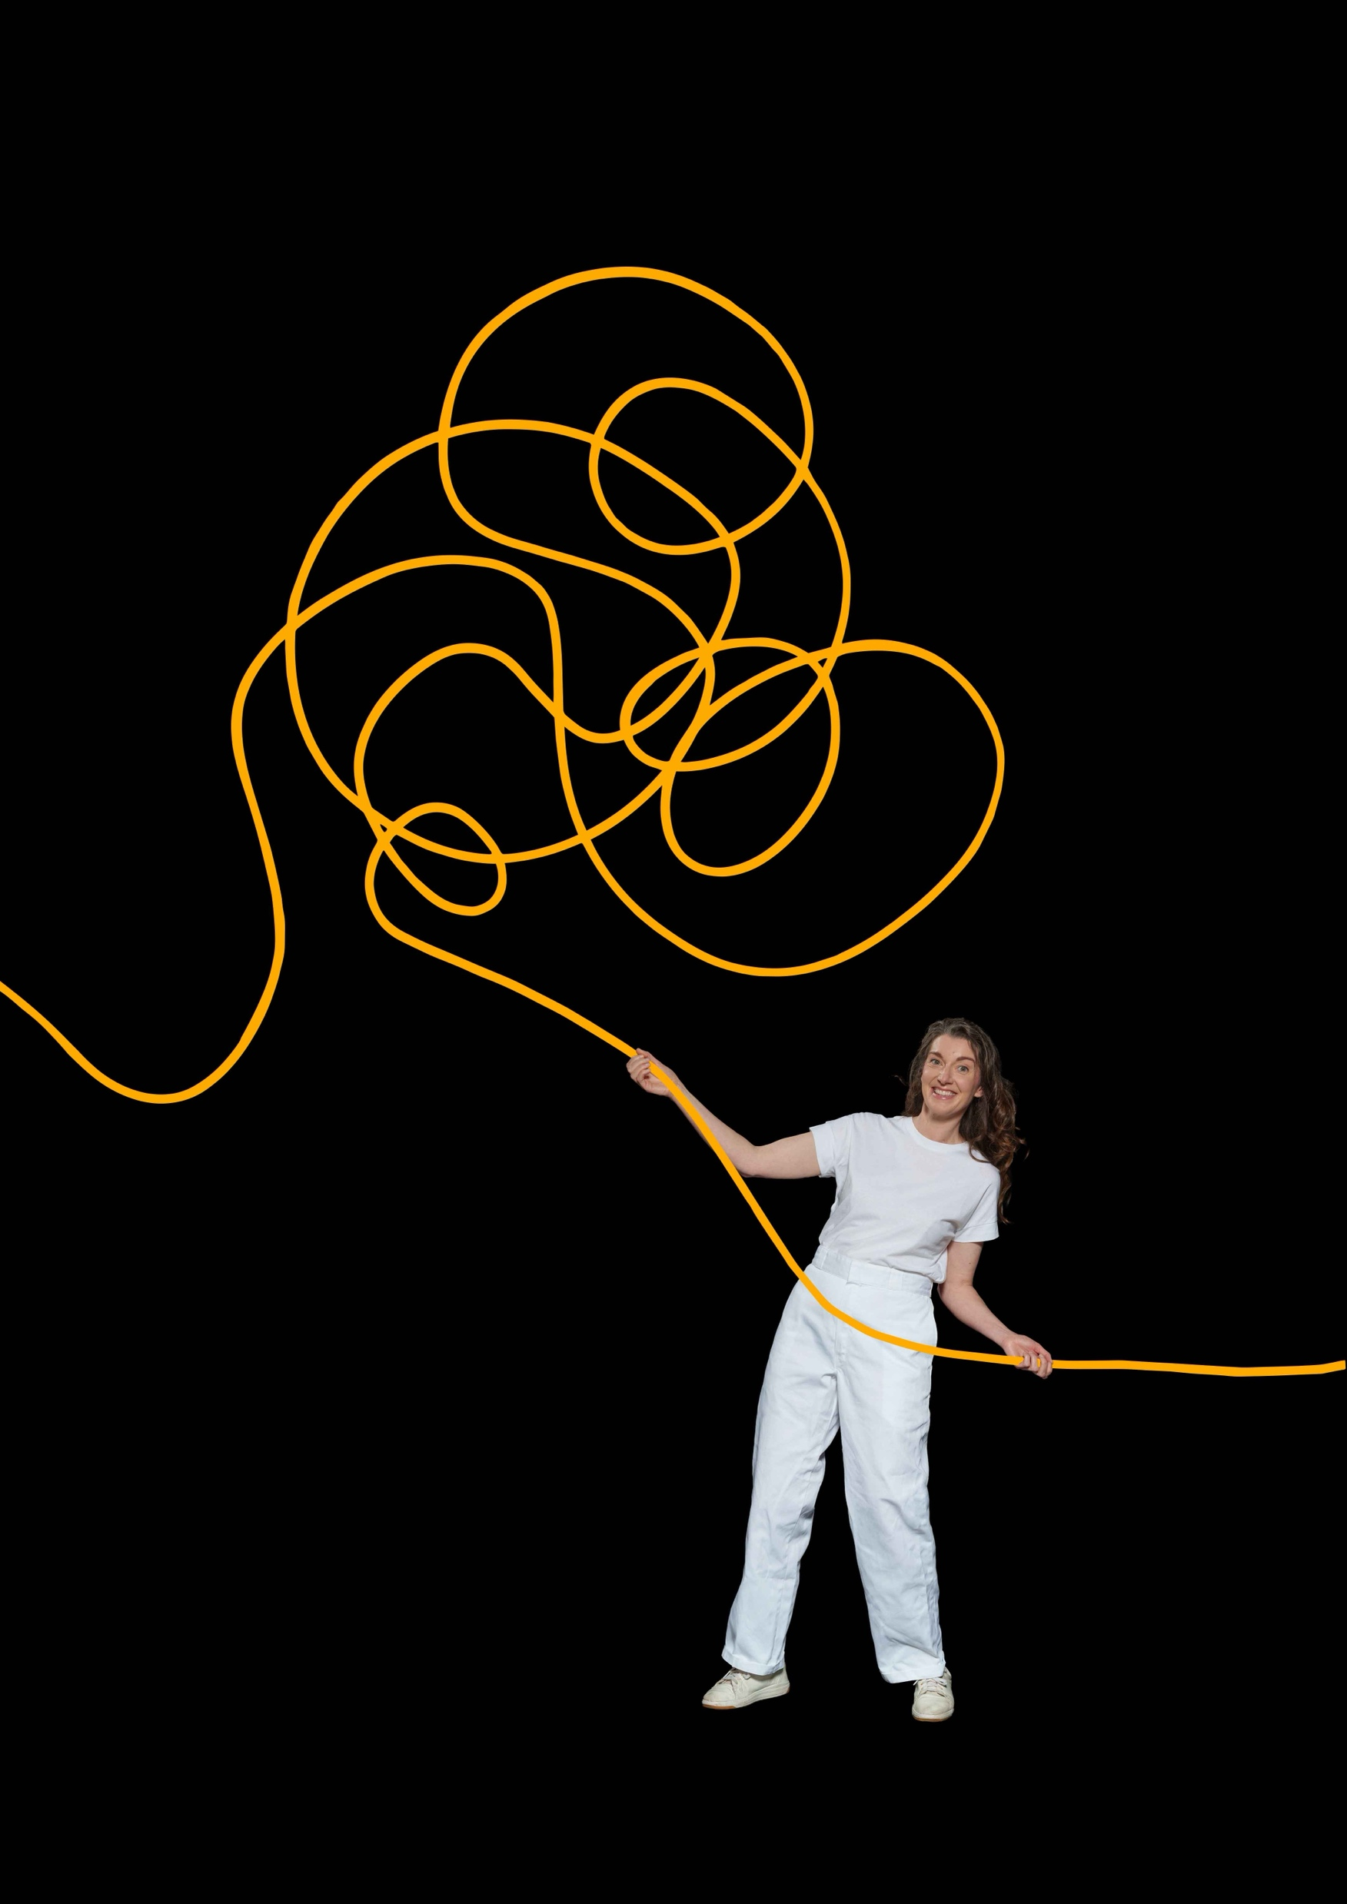
Soon, my class and I will see a show called It’s a String Thing.
It is a live performance at our school.
A performer will visit us. We do not have to travel anywhere.
Image description: A person wearing white is holding an orange rope which is squiggling around and above her.
1

Slide 6
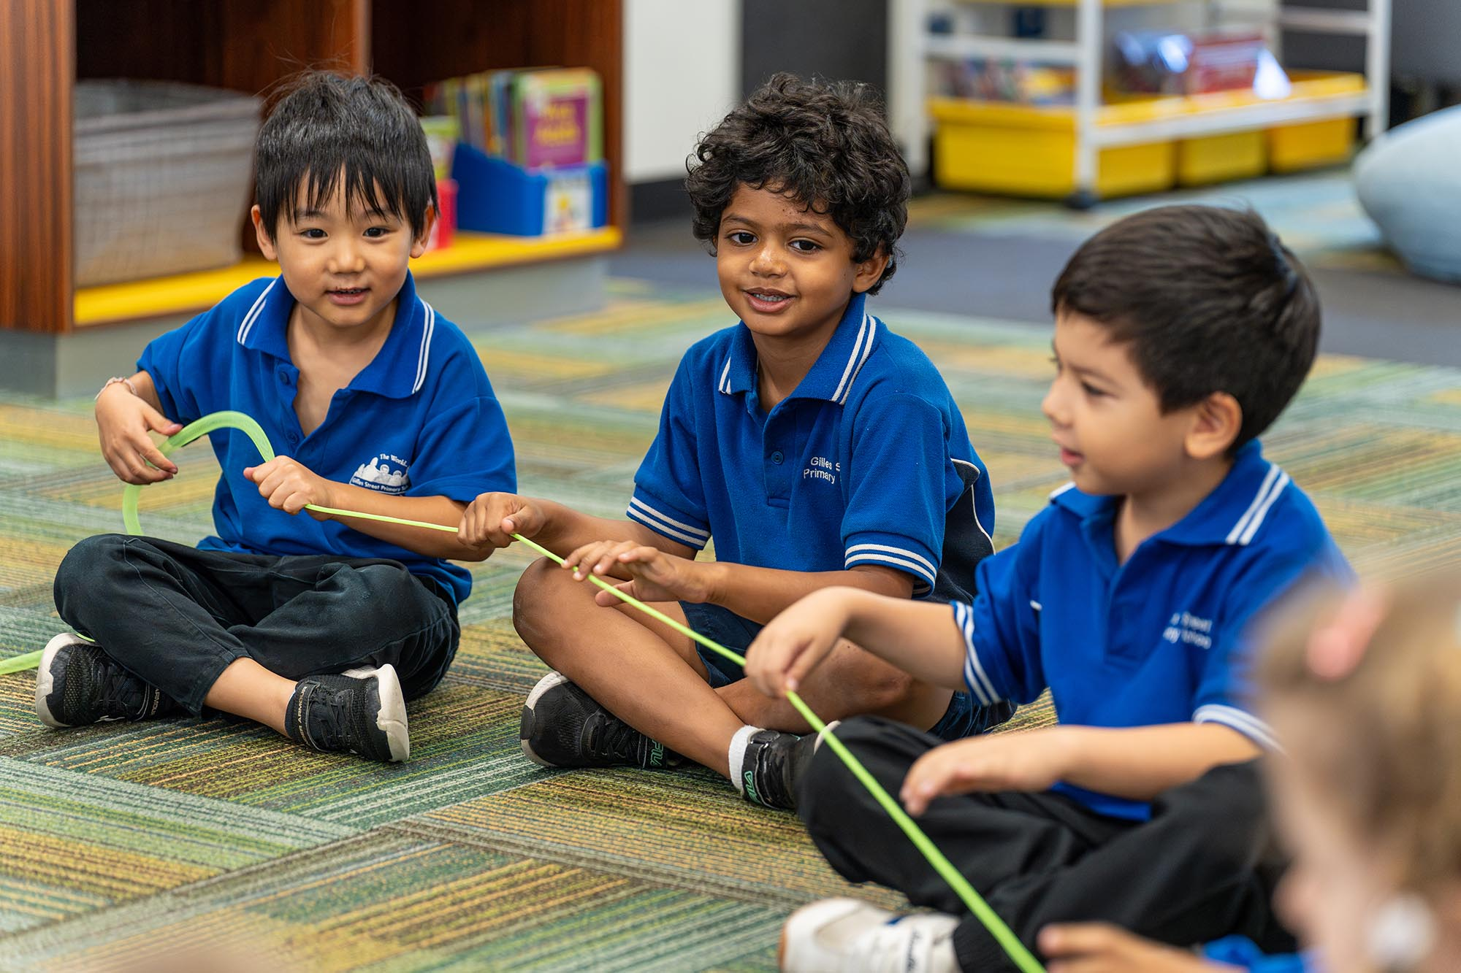
It’s a String Thing is a story about all the things a piece of string could be.
It is about:
  adventures
  family and friends
  imagination
The story is playful and adventurous.
Image description: A group of children sitting on the floor holding a string
2

Slide 7
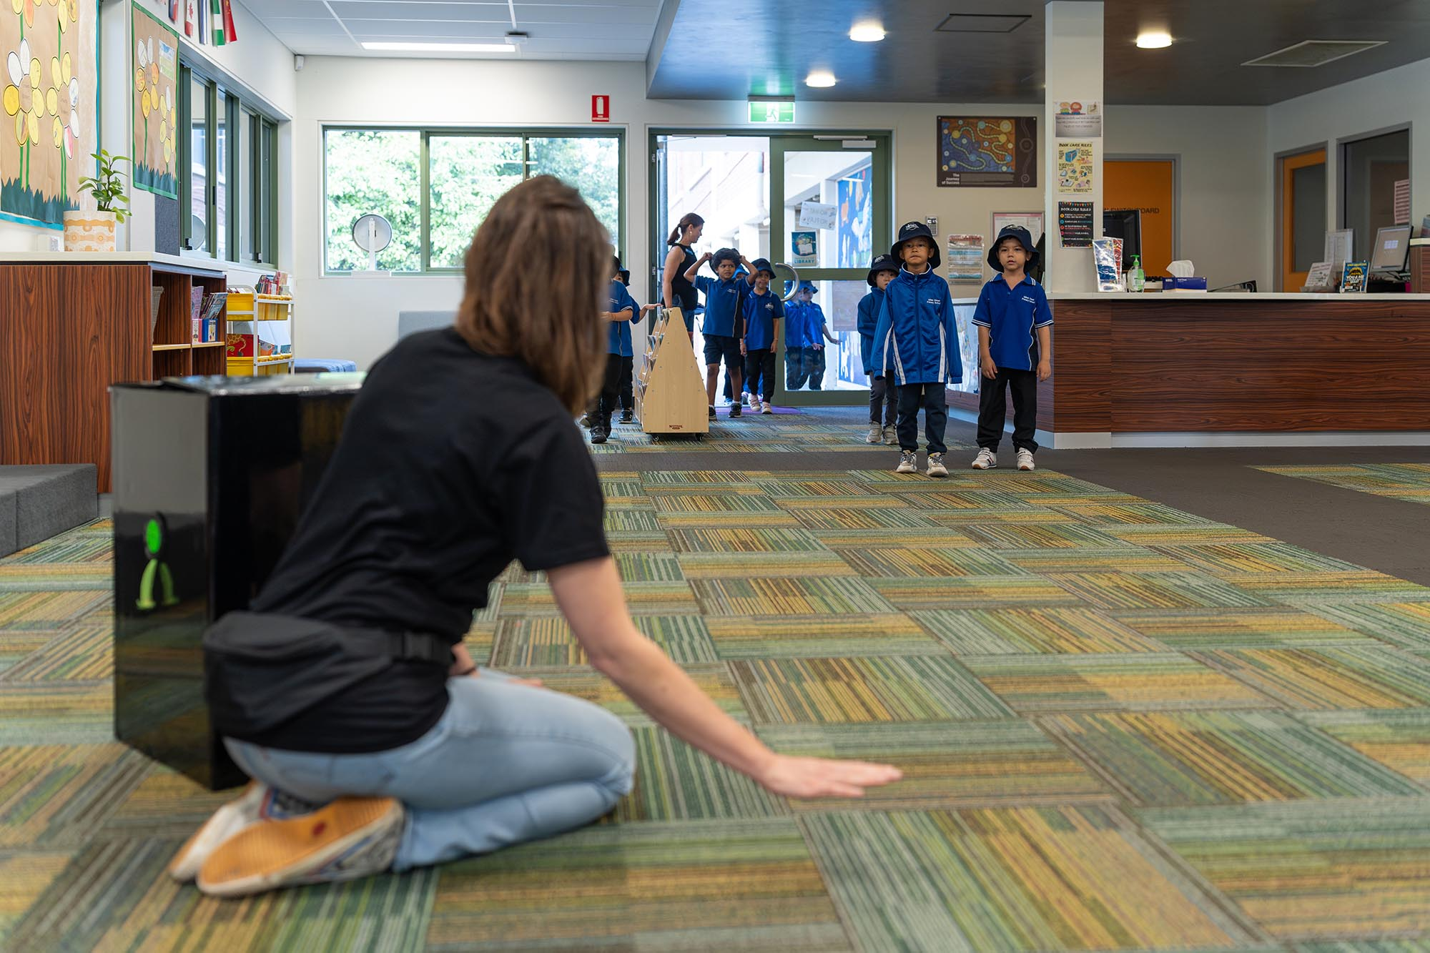
We will meet the performer in our school.
She will have a big box with her.
When we arrive, she will ask us to sit in a circle.
I will sit in a circle on the floor with my class and teachers.
The performer will sit with us.
Image description: A person is kneeling on the floor in a library. She is welcoming a group of children.
5

Slide 8
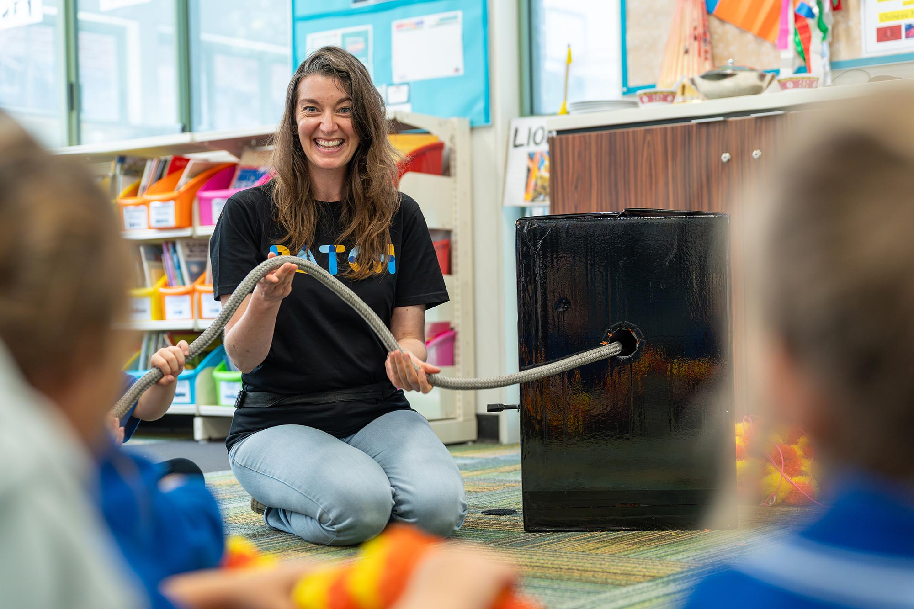
The performer will wear everyday clothes, perfect for playing.
I will be invited to join in. I do not need to if I don’t want to.
There will be space for us to move.
There will be space for wheelchairs.
Image description: A person wearing jeans and a t-shirt sitting next to a black box holding a length of grey rope.
3

Slide 9
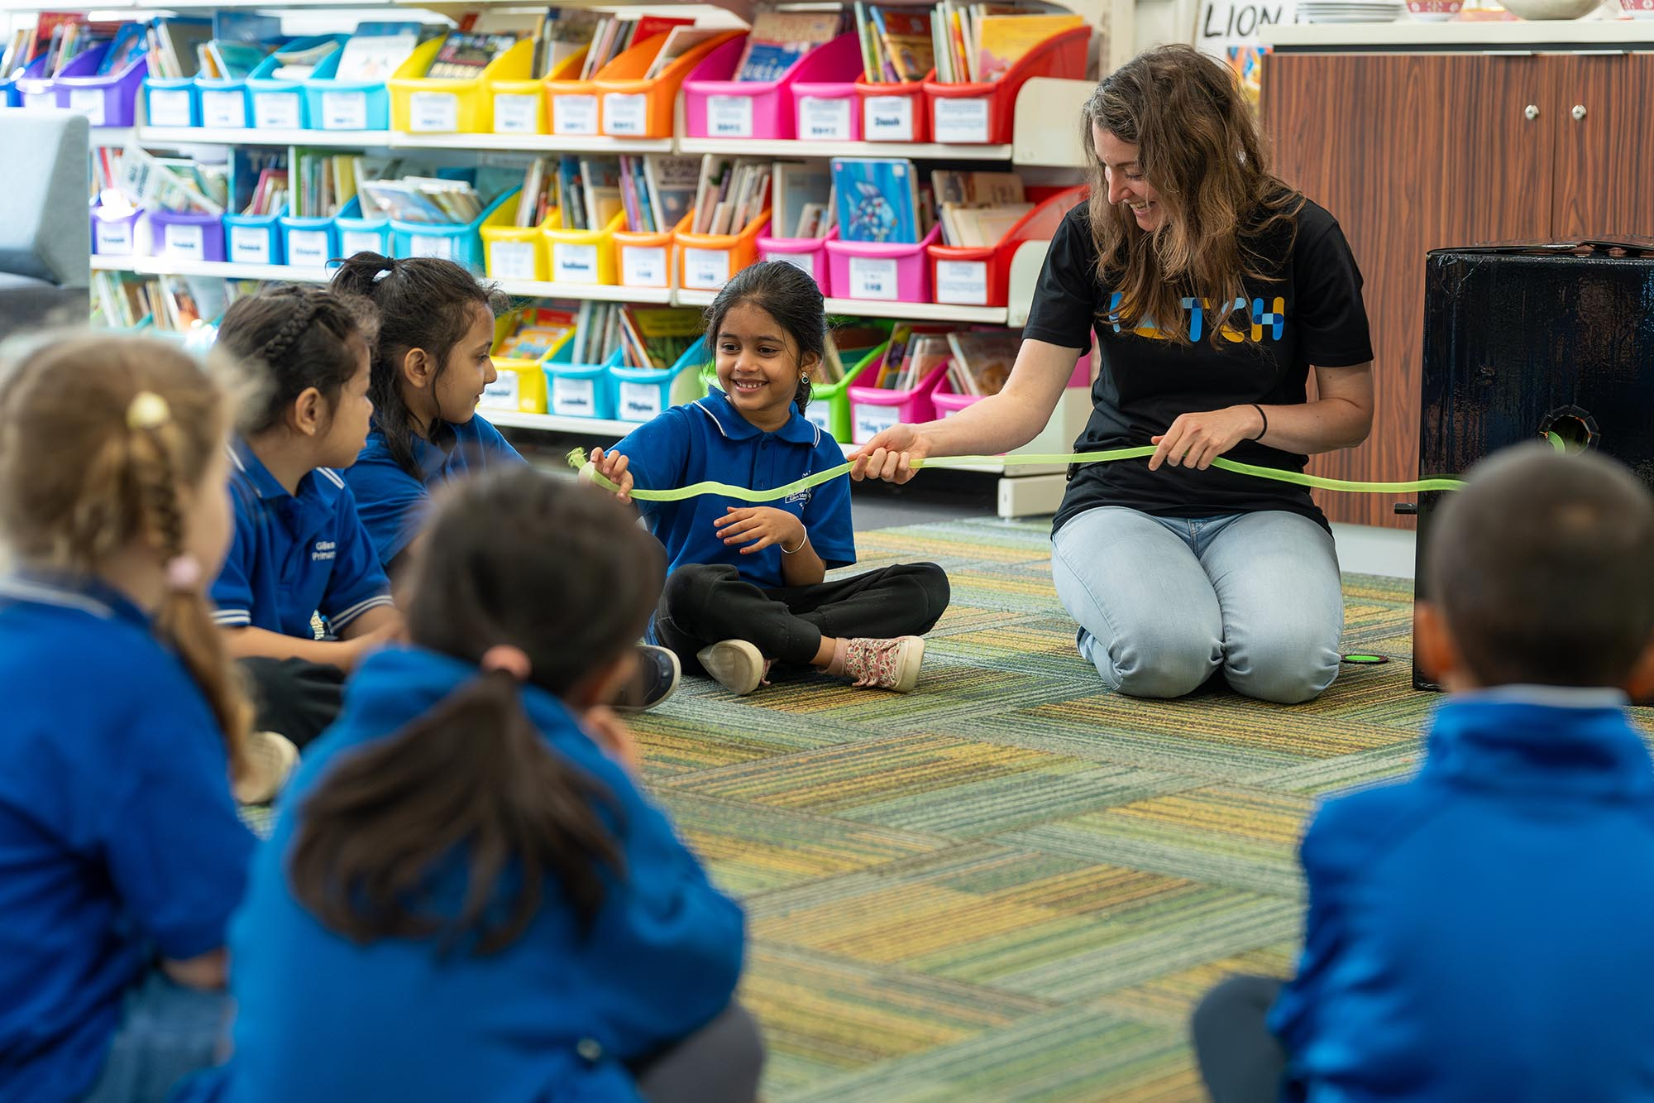
The performer will pull a piece of string from the box.
She will tell us a story about the string.
It will be fun and full of adventure.
Even if something looks surprising, we will be safe.
We will be pretending and enjoying ourselves.
Image description: A group of children sitting on the floor with an adult holding a green string.
1

Slide 10
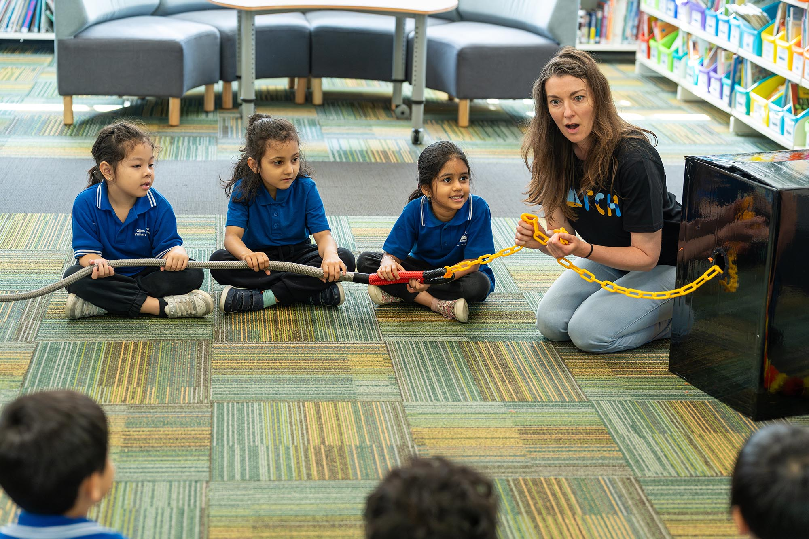
The string will be made of different things.
It will be different colours.
It may be soft, or hard, or bendy.
It may be big, or small, or make a gentle noise.
If I don’t like how the string feels, I don’t have to touch it.
Image description: A group of children sitting on the floor with a person holding a rope and a chain.
6

Slide 11
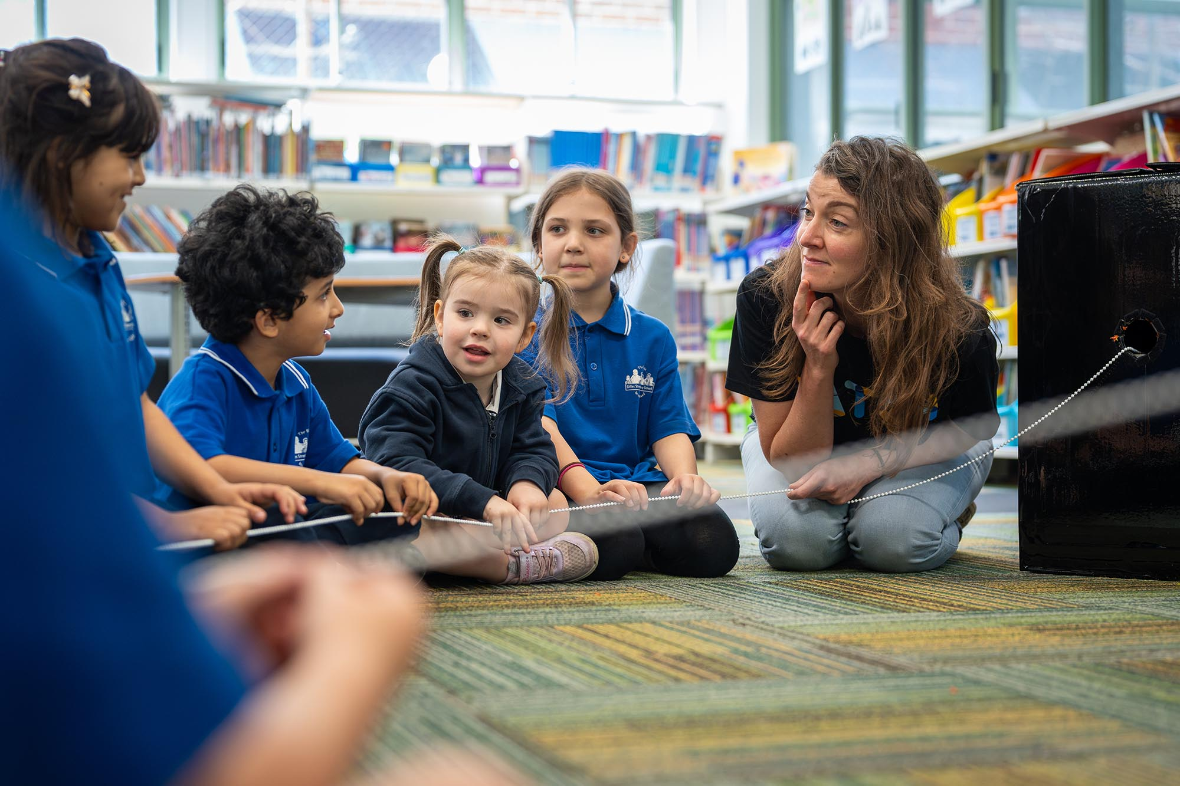
The performer may ask me questions. I can answer if I want to.
The performer may ask me to make sounds. I can if I want to.
Image description: A group of children sitting on the floor next to an adult who look curious.
7

Slide 12
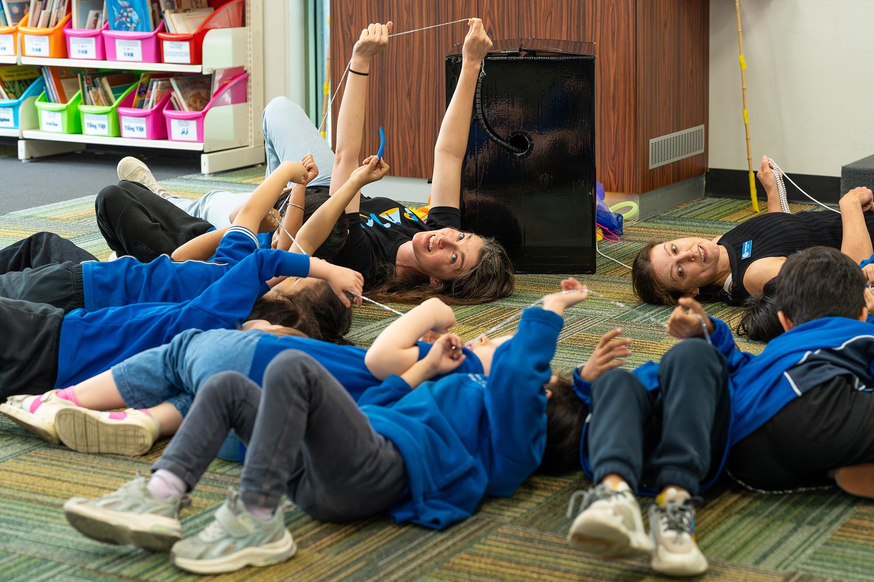
The performer may ask me to stand up or lie down. I can move if I want to.
The performer may ask me to do things with the string. I can if I want to.
Image description: A group of people lying on the floor holding a silver string above their heads.
7

Slide 13
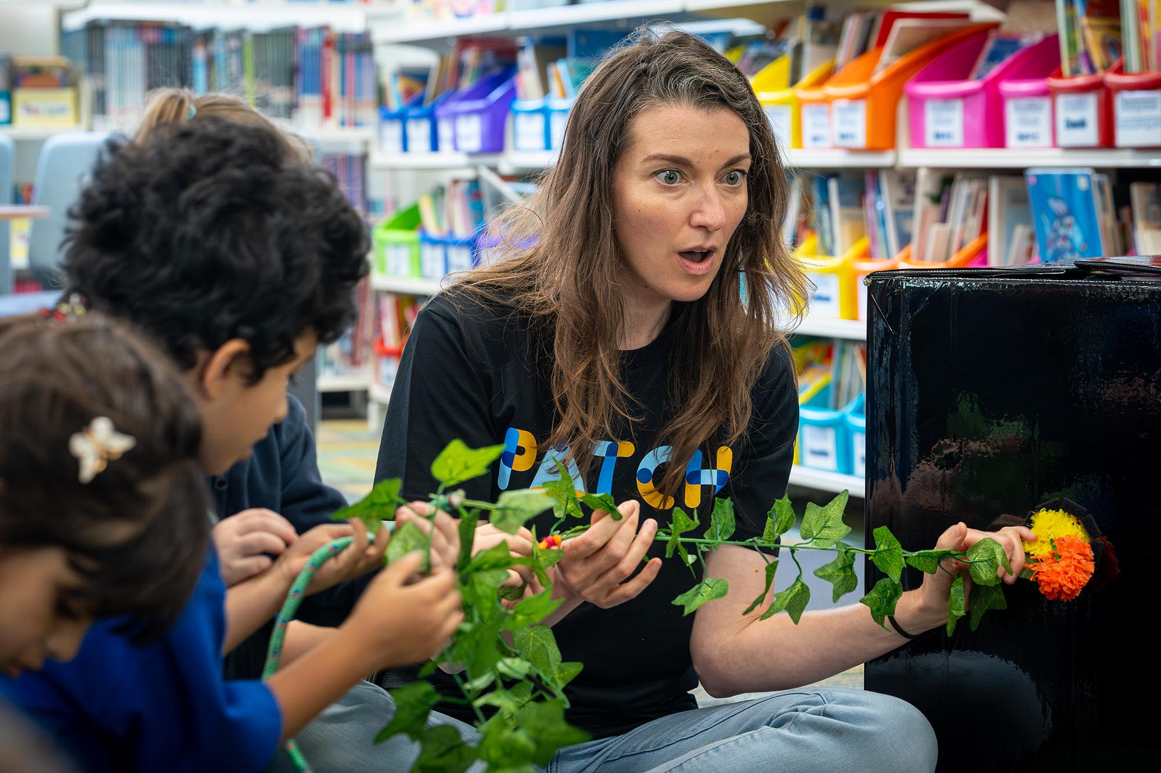
I can make sounds to show how I feel, like laughing or saying “wow”.
I can use my imagination.
I can be creative.
I can join in telling the story.
Image description: A person and children holding a string made of leaves, they looked surprised.
9

Slide 14
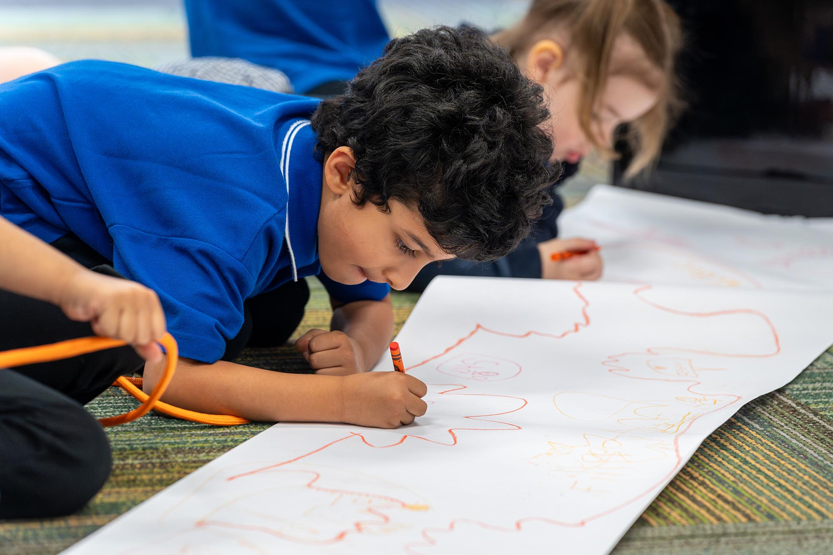
The performer will give us crayons.
She will ask us to draw.
I can draw something from the show.
Or I can draw something from my imagination.
Image description: A child draws on a sheet of large white paper with an orange crayon.
8

Slide 15
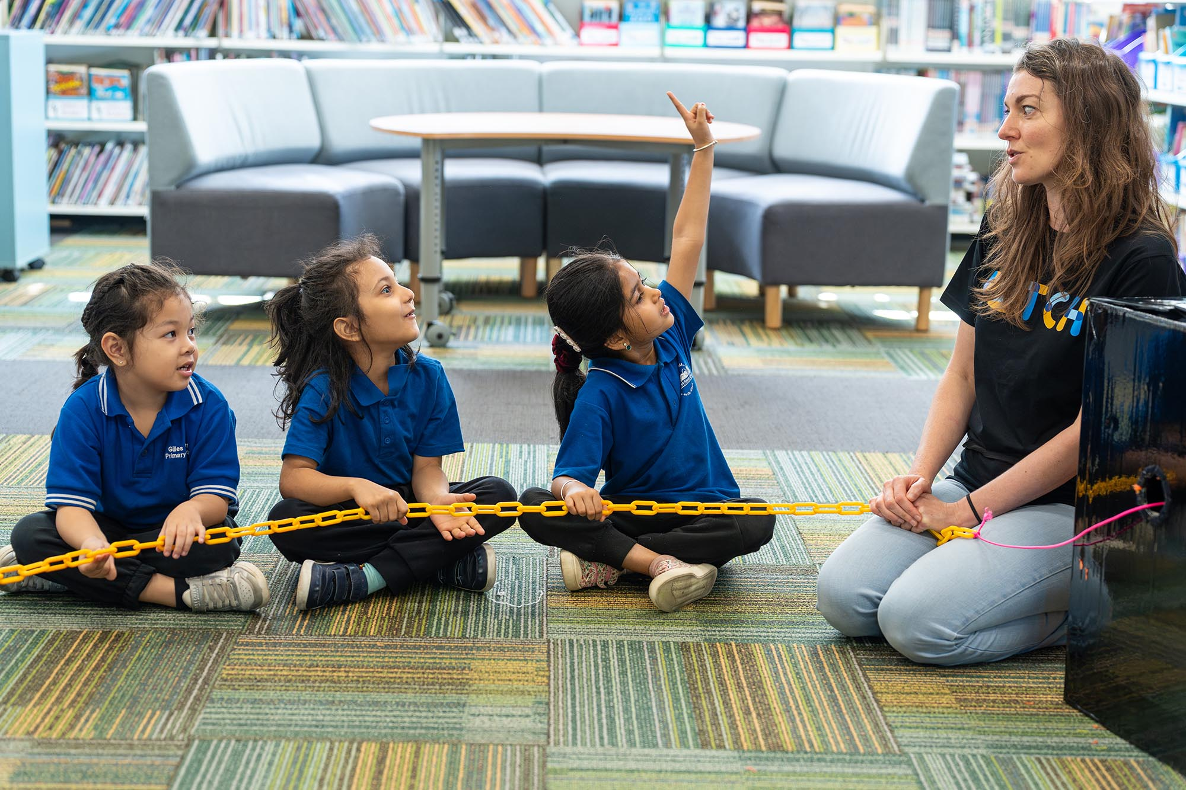
The show goes for 40 minutes.
If I need help, I can let an adult know.
An adult can assist me to leave the space during the show if needed.
I can come back when I am ready.
Image description: A group of children sit on a floor with an adult, they are holding an orange chain.
10

Slide 16
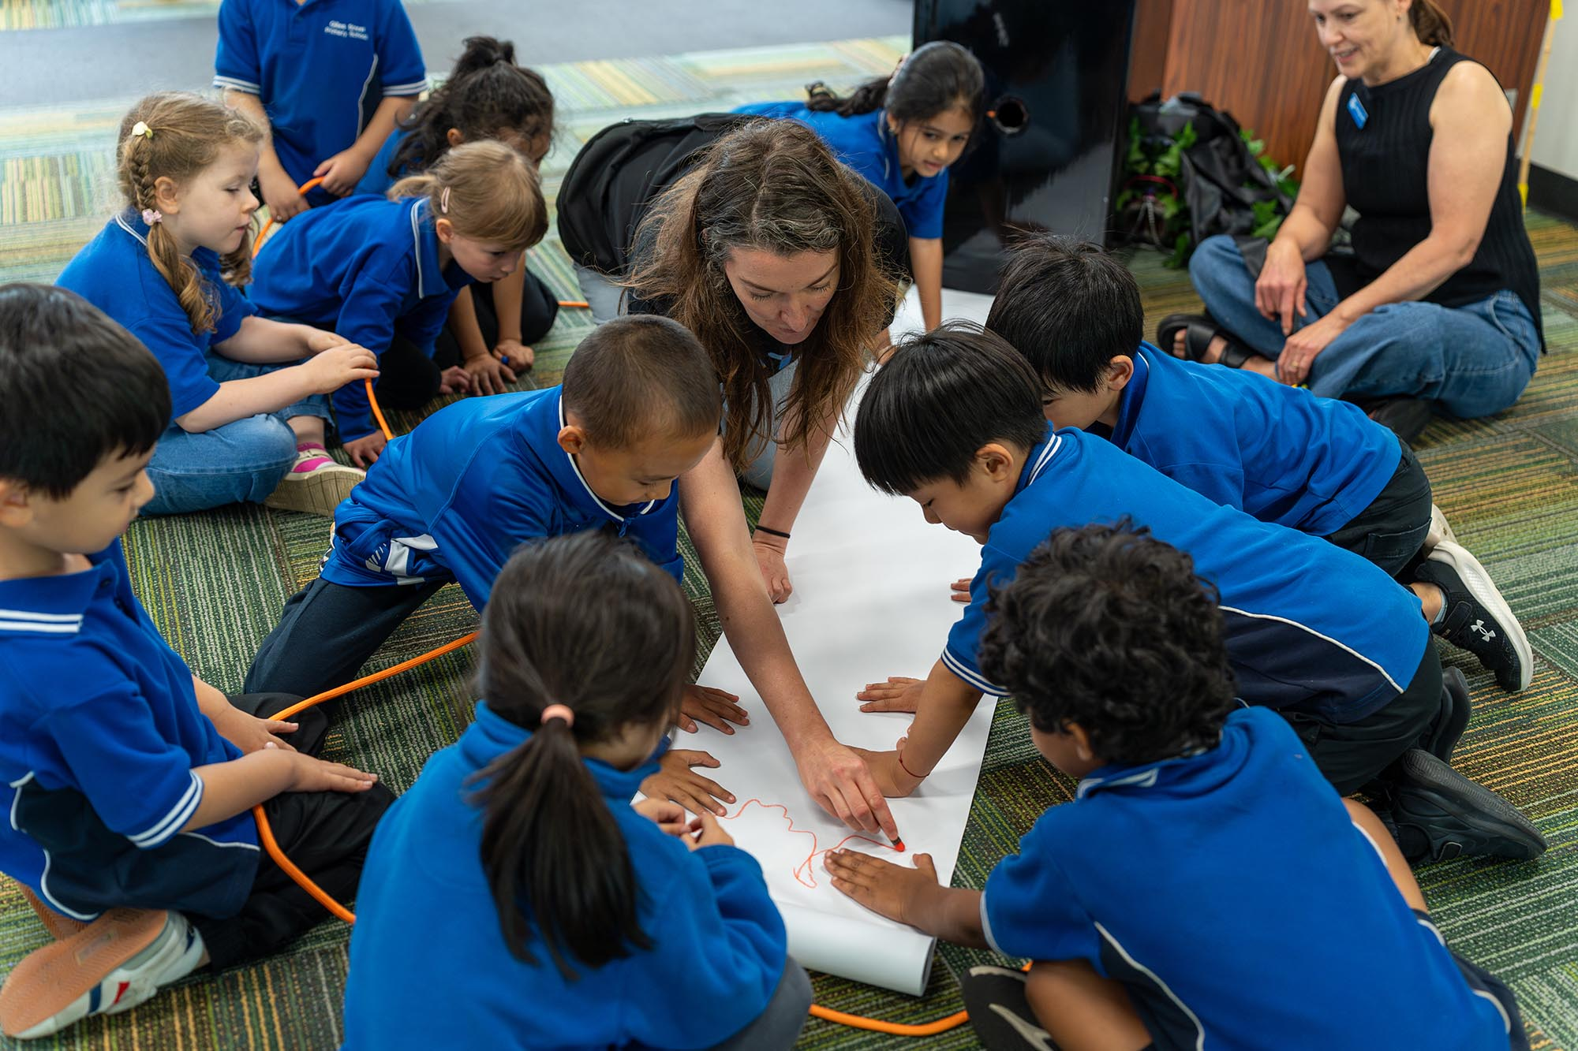
When the show finishes, we can clap to say thank you.
Some people might even cheer!
I might feel happy, calm or even sad that it is ending. That is ok.
I can express my feelings in a way that is comfortable for me.
Image description: A group of children sit on the floor drawing on a piece of paper or holding an orange string.
11

Slide 17
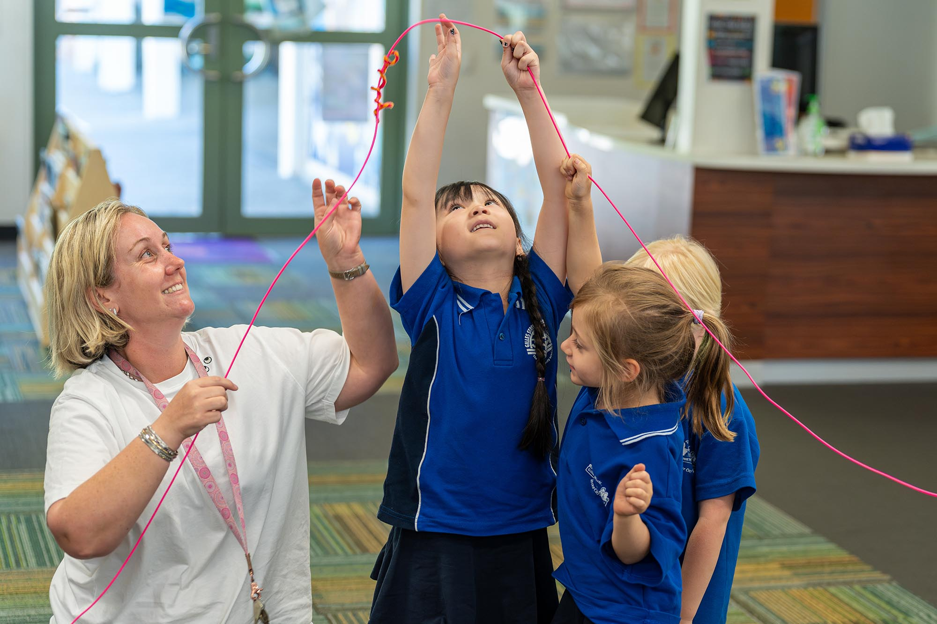
When we leave, I might:
  talk about my favourite part
  think about the string and our adventures
  tell my family about the story
Everyone experiences It’s a String Thing in their own way.
Image description: A teacher and a group of children play with a pink string.
12

Slide 18
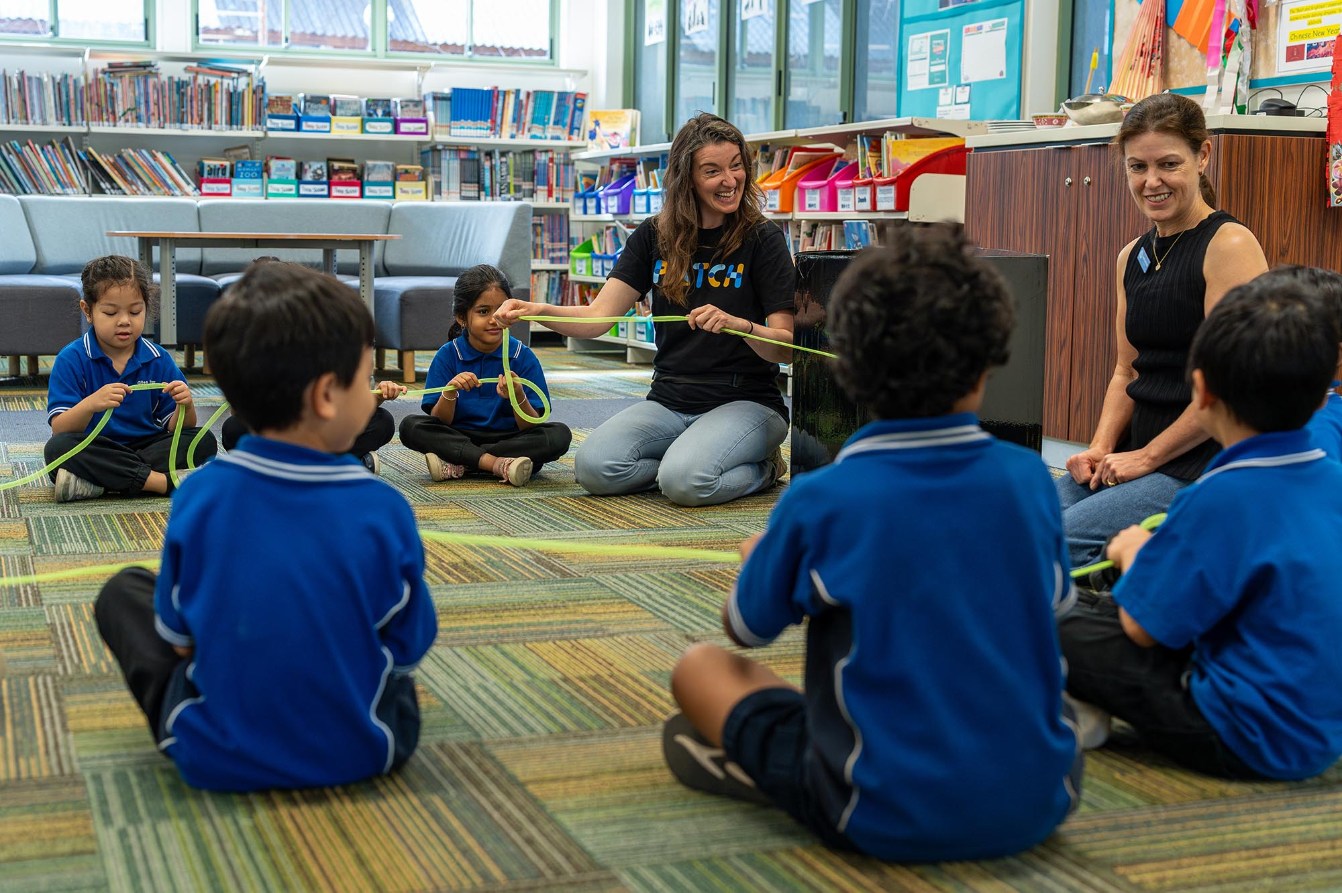
Patch Theatre is looking forward to seeing you at
It’s a String Thing!
Image description: A group of children sit on the floor with adults, they are holding a green string.
13

