Slide 1

Visual Story
ME & MY SHADOW
Space Theatre, Adelaide Festival Centre
August 2026
What to expect at Me & My Shadow, a visual story for children.

Slide 2
What’s in this guide?
This visual story will guide you through Me & My Shadow, a theatre performance by Patch Theatre.
We have detailed the experience and noted audio and visual details for those with sensory sensitivities.
You can read through this guide before your visit so you can get to know the show and let children know what to expect.
Please keep an eye on our website for any version updates to this guide.
For more information, please contact Patch Theatre:
Website: www.patchtheatre.org.au/
FAQs: www.patchtheatre.org.au/news/me-and-my-shadow-faqs
Email: patch@patchtheatre.org.au
Phone: (08) 8470 0165
Show warnings: None
Venue accessibility: For access information for Adelaide Festival Centre venues, please visit
www.adelaidefestivalcentre.com.au/your-visit/accessibility
Show photography by Matt Byrne and other uncredited photographers. Other imagery generated by AI.
This guide was created by Patch Theatre (2026).
Version 1.15 012026

Slide 3
Theatre for everyone
We warmly welcome people with access needs or sensory sensitivities to our shows.
Me & My Shadow features very little spoken language. Our performers will use Auslan to signpost some key moments in the show to ensure d/Deaf people and Auslan users can have an equally enjoyable experience.
The Adelaide Festival Centre accommodates people with access needs and is wheelchair accessible. Check their website for information, the front-of-house team will be available to assist you during your visit.
www.adelaidefestivalcentre.com.au/your-visit/accessibility
Here are some other good things to know:
there are no sudden or very loud sounds in the sound design or music
low level lighting is used throughout the show to create effects but there are no periods of total darkness
we take a relaxed approach to audience noise and movement, and children who need a break are welcome to exit and re-enter with guidance from the front-of-house team
we recommend bringing earmuffs or dark glasses for children who may find the show over-stimulating

Slide 4
Visual Story
ME & MY SHADOW
A guide for children about what
they will see and hear.

Slide 5
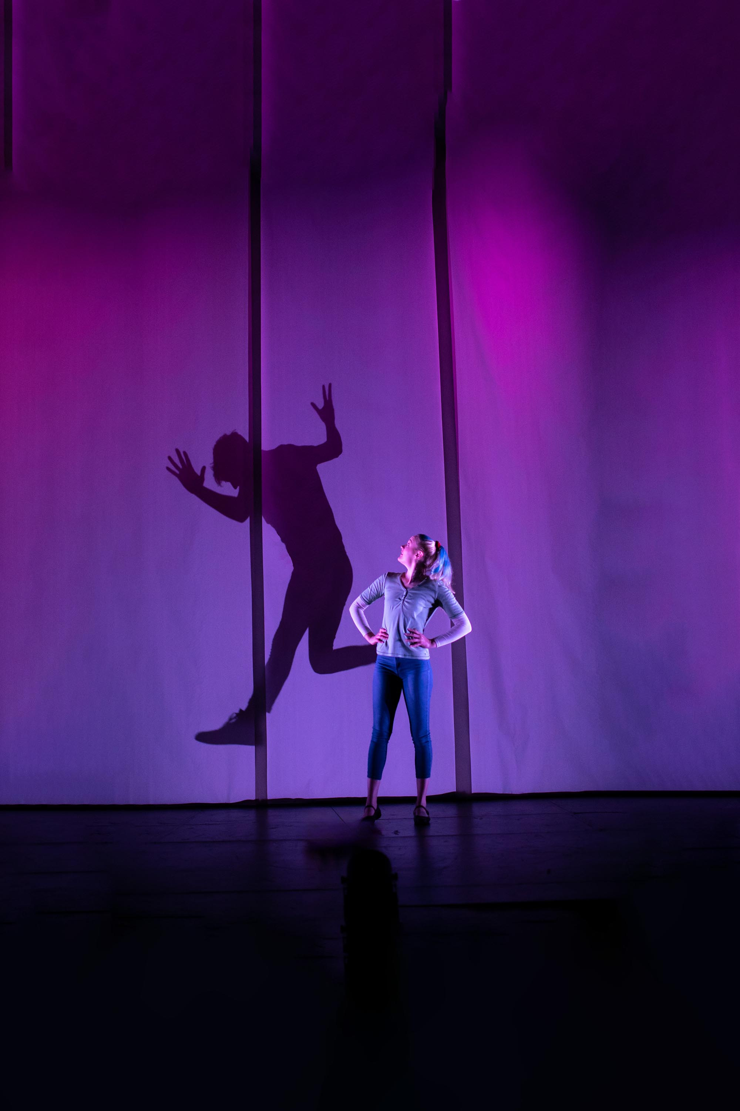
Soon, my class and I are going to see a show called Me & My Shadow.
It is a live performance in a theatre.
I will sit in my seat and watch the show on stage.
I do not need to join in.
My teachers and classmates will be with me.
Image description: A person stands on a dark stage in front of a purple background. She has her hands on her hips and looks over her shoulder at her shadow which is jumping up in the air.
1

Slide 6
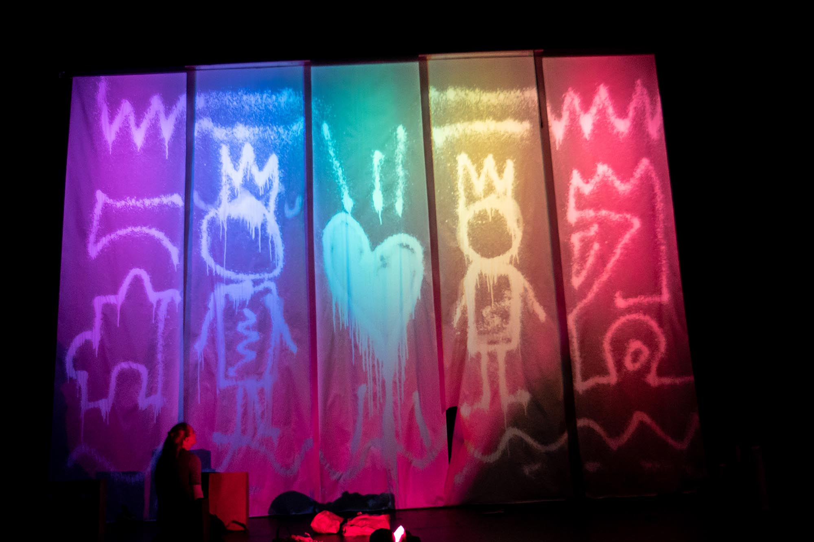
Me & My Shadow is a story about a person and their shadow becoming friends.
It is about:
meeting someone new
learning how to play together
solving problems
sharing joy
The story is gentle and playful.
Image description: A person sits on a floor looking up at a wall. There are colourful drapes hanging down with drawings on them.
2

Slide 7
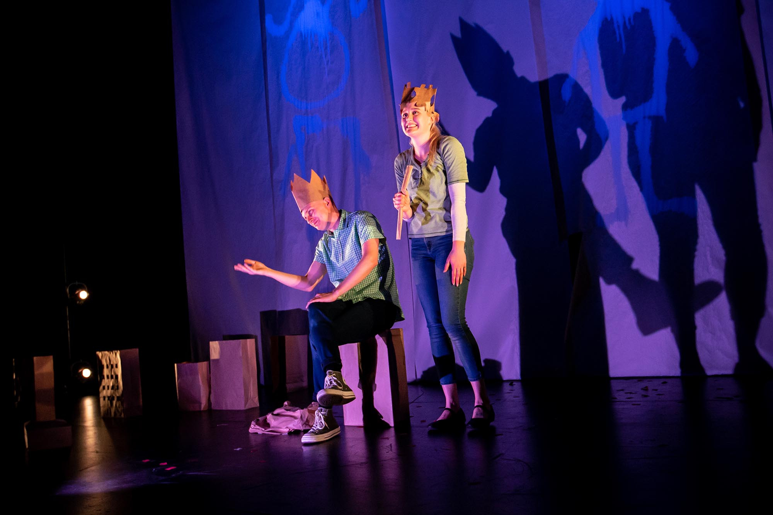
There are two performers on stage.
They wear everyday clothes, perfect for playing.
Even when something looks surprising, the performers are safe.
They are pretending and enjoying themselves.
Image description: A person stands on stage with her hands on her hips. Behind her a shadow is jumping up in the air.
3

Slide 8
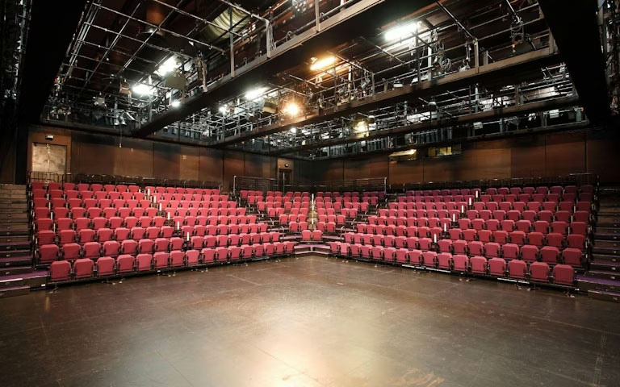
In the theatre, there will be a stage. This is where the performers act.
There will be lots of seats. I will sit here with my class and teachers.
There will also be some mats on the floor in front on the stage.
Some children will sit on them.
There are spaces for wheelchairs.
Image description: Taken from the stage, an empty theatre is ready for its audience. The seats are red and we see lighting rigging in the ceiling.
4

Slide 9
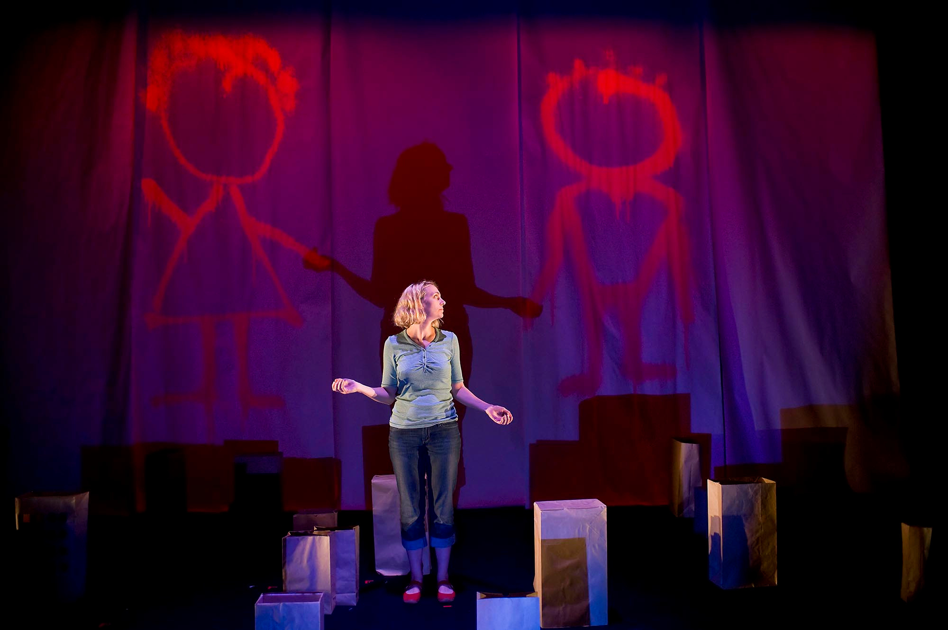
On the stage, I will see:
two performers who act and tell the story
large drapes which hang from the ceiling
paper bags that change into different things
light and shadow moving and changing size
colours appearing and disappearing
Image description: A person stands in front of a backdrop on which has hand drawn people on it, and her large shadow. She is surrounded by paper bags on the floor.
5

Slide 10
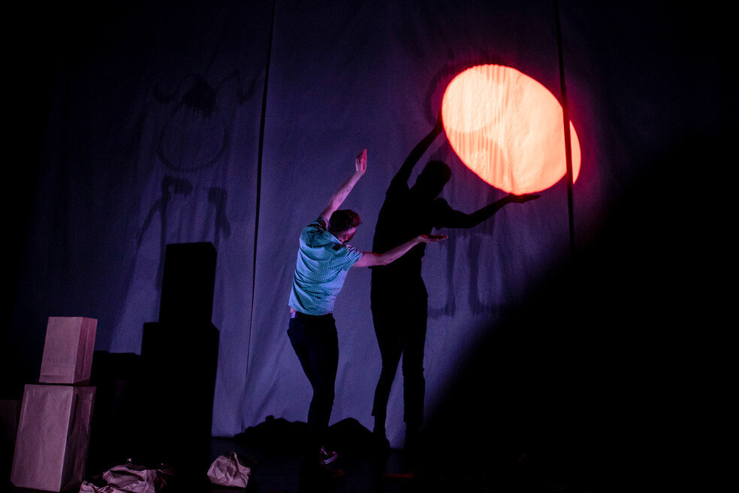
Light
Some parts of the show are darker so I can see the shadows clearly.
There will be lights in different colours.
If I don’t like how the lights feel, I can wear dark glasses or cover my eyes.
Image description: A person holds both arms above his head. His shadow looks like it is holding a ball of light which shines on the wall behind him.
6

Slide 11
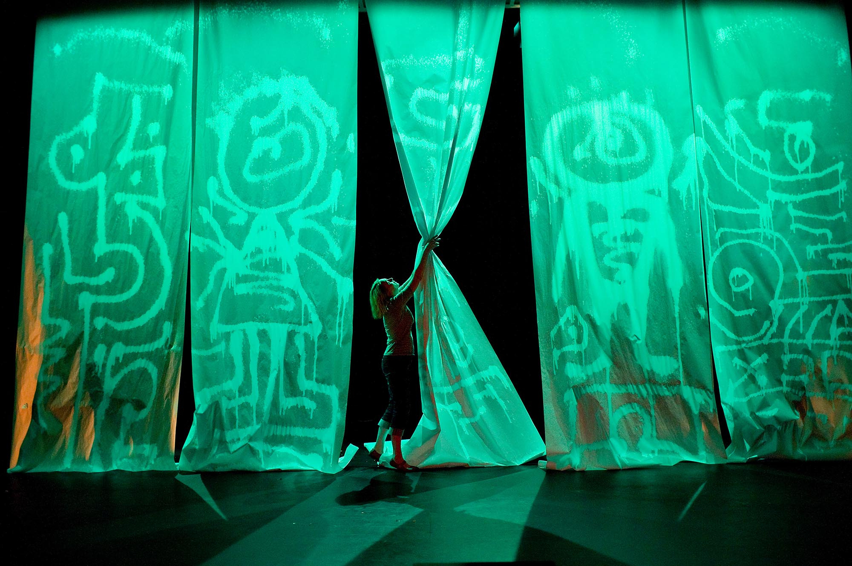
Sound
The performers will laugh, say some words, make sounds and use Auslan.
There will be music and sound played through speakers.
Sometimes it will be quiet and calm.
Sometimes it will be a little louder.
There will not be any very loud or sudden sounds.
Image description: A person reaches up to grab a long curtain. Around her other curtains hang from the ceiling and they are lit up in green light.
7

Slide 12
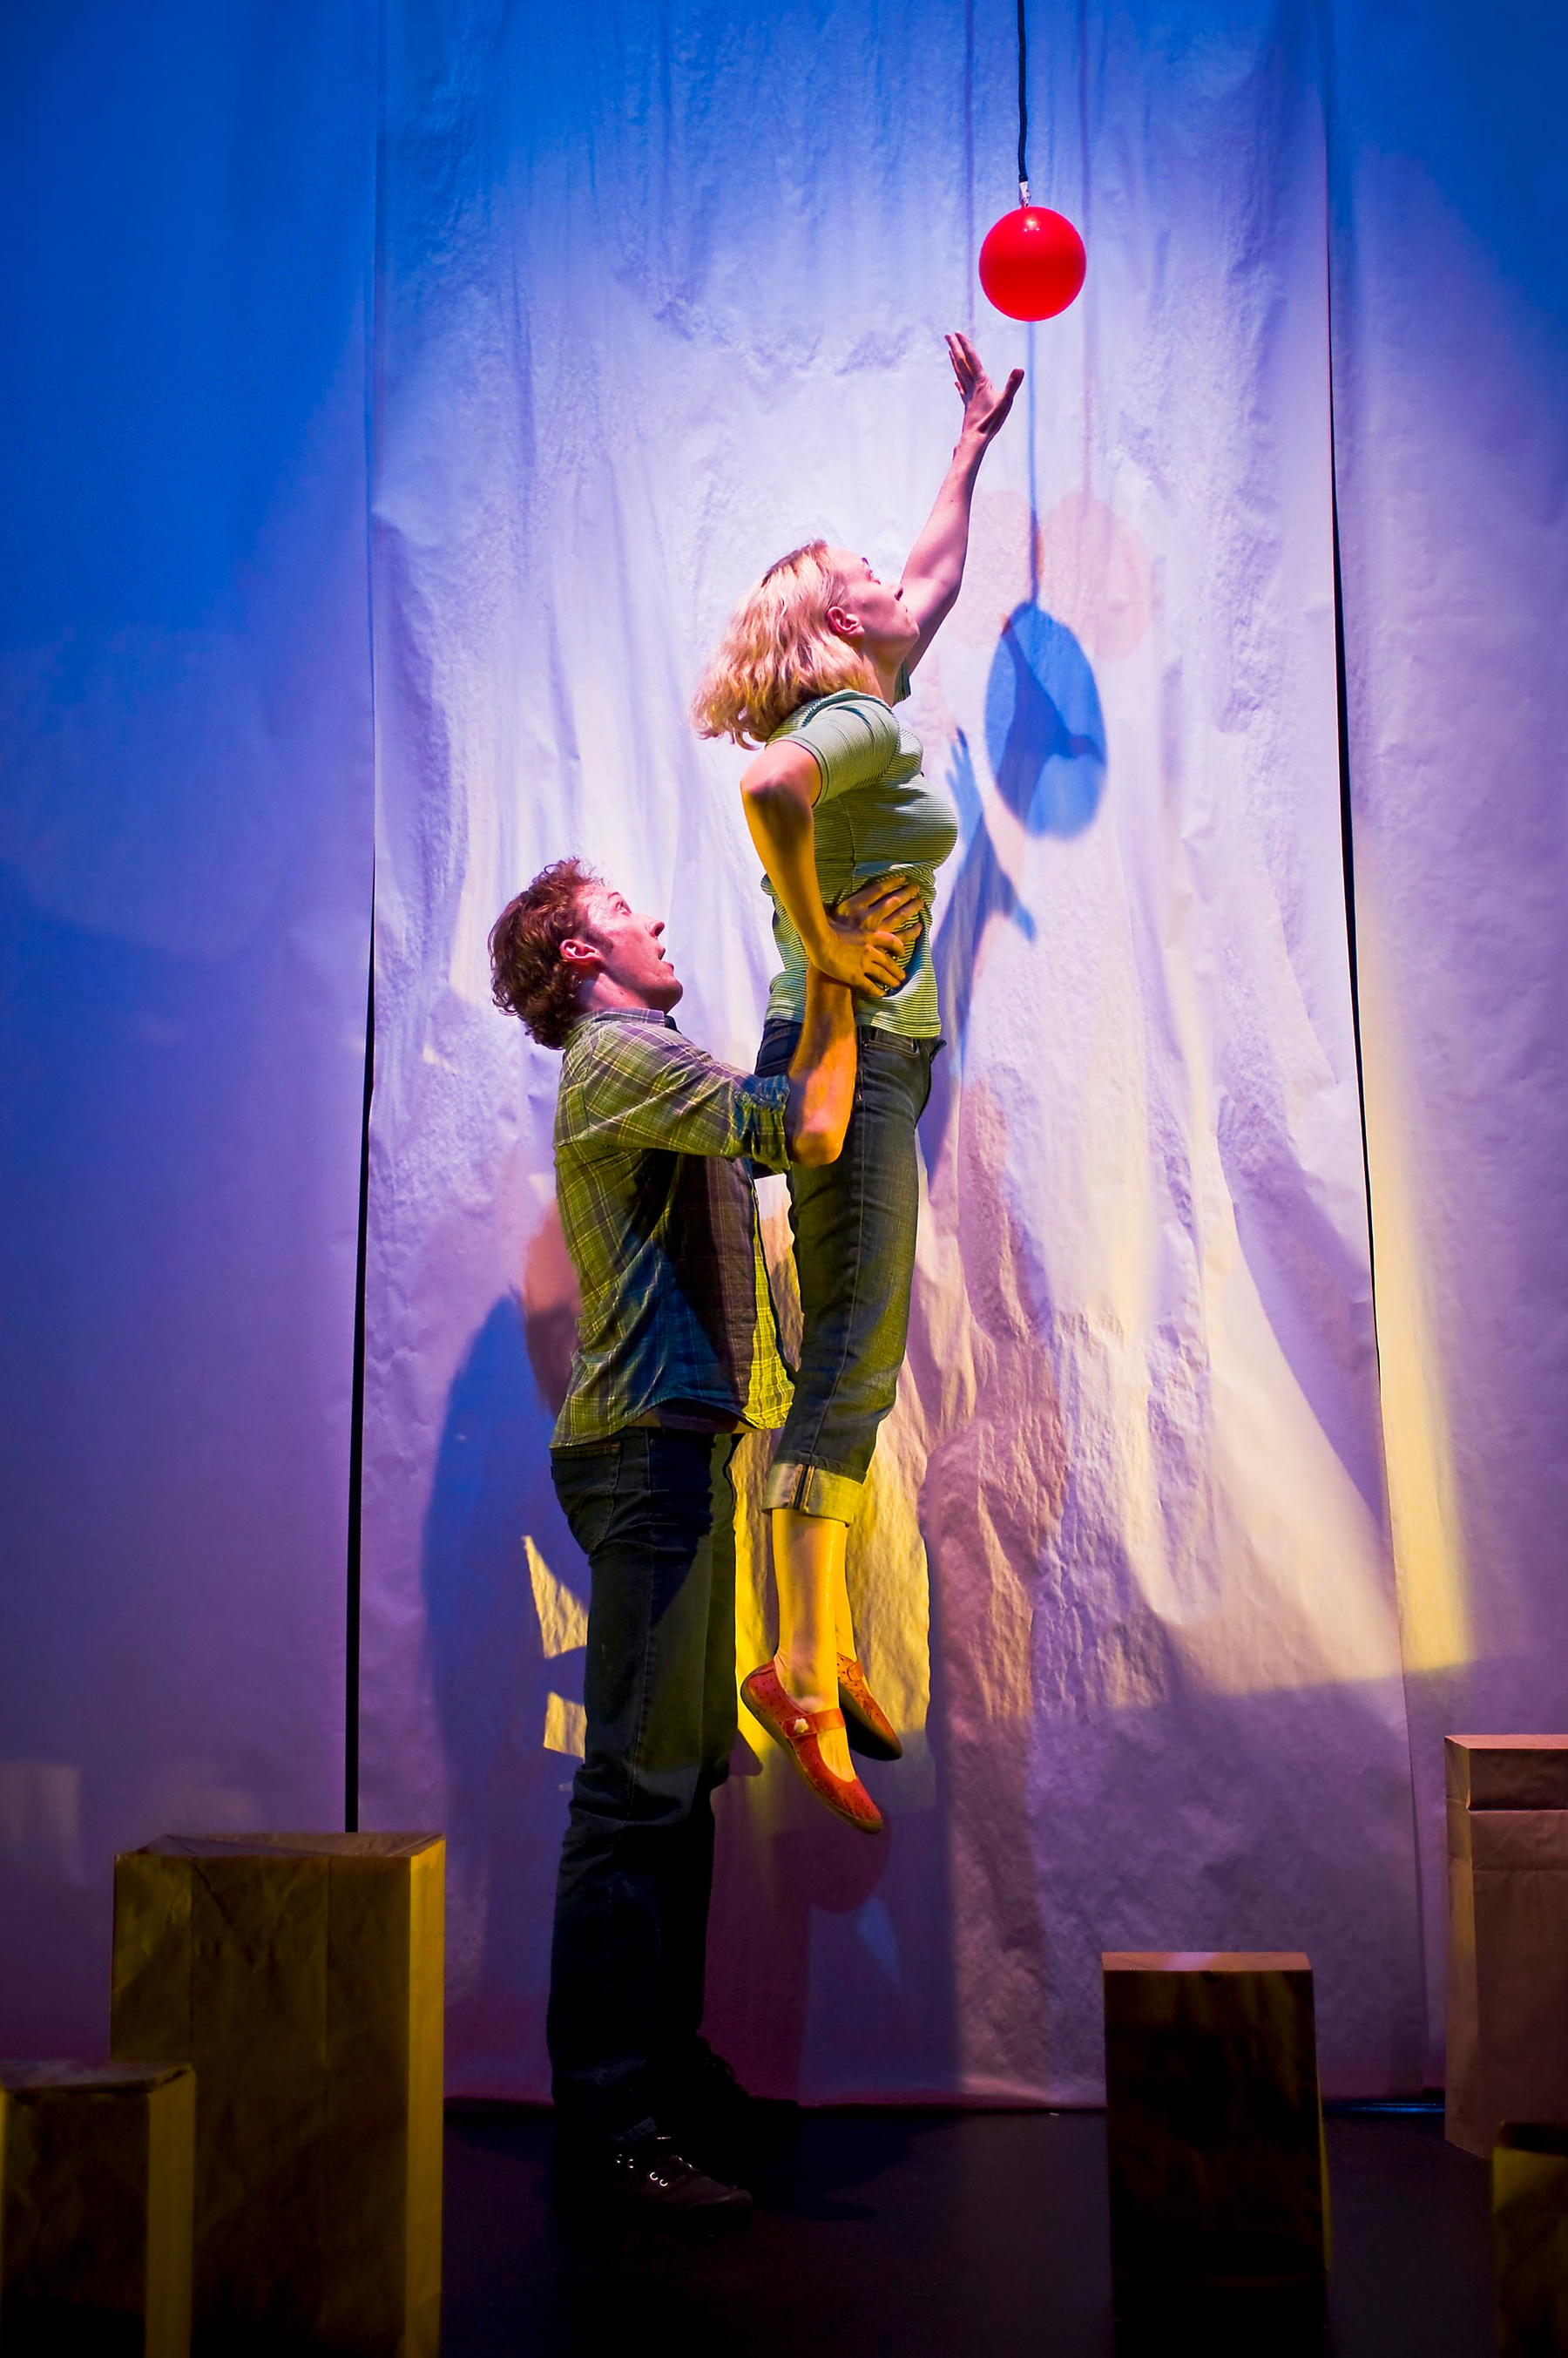
Movement
The performers move their bodies to tell the story.
They run around, play and do special tricks.
I will stay in my seat and watch.
Image description: A person lifts up another person by the hips. She is reaching up to catch a red ball.
8

Slide 13
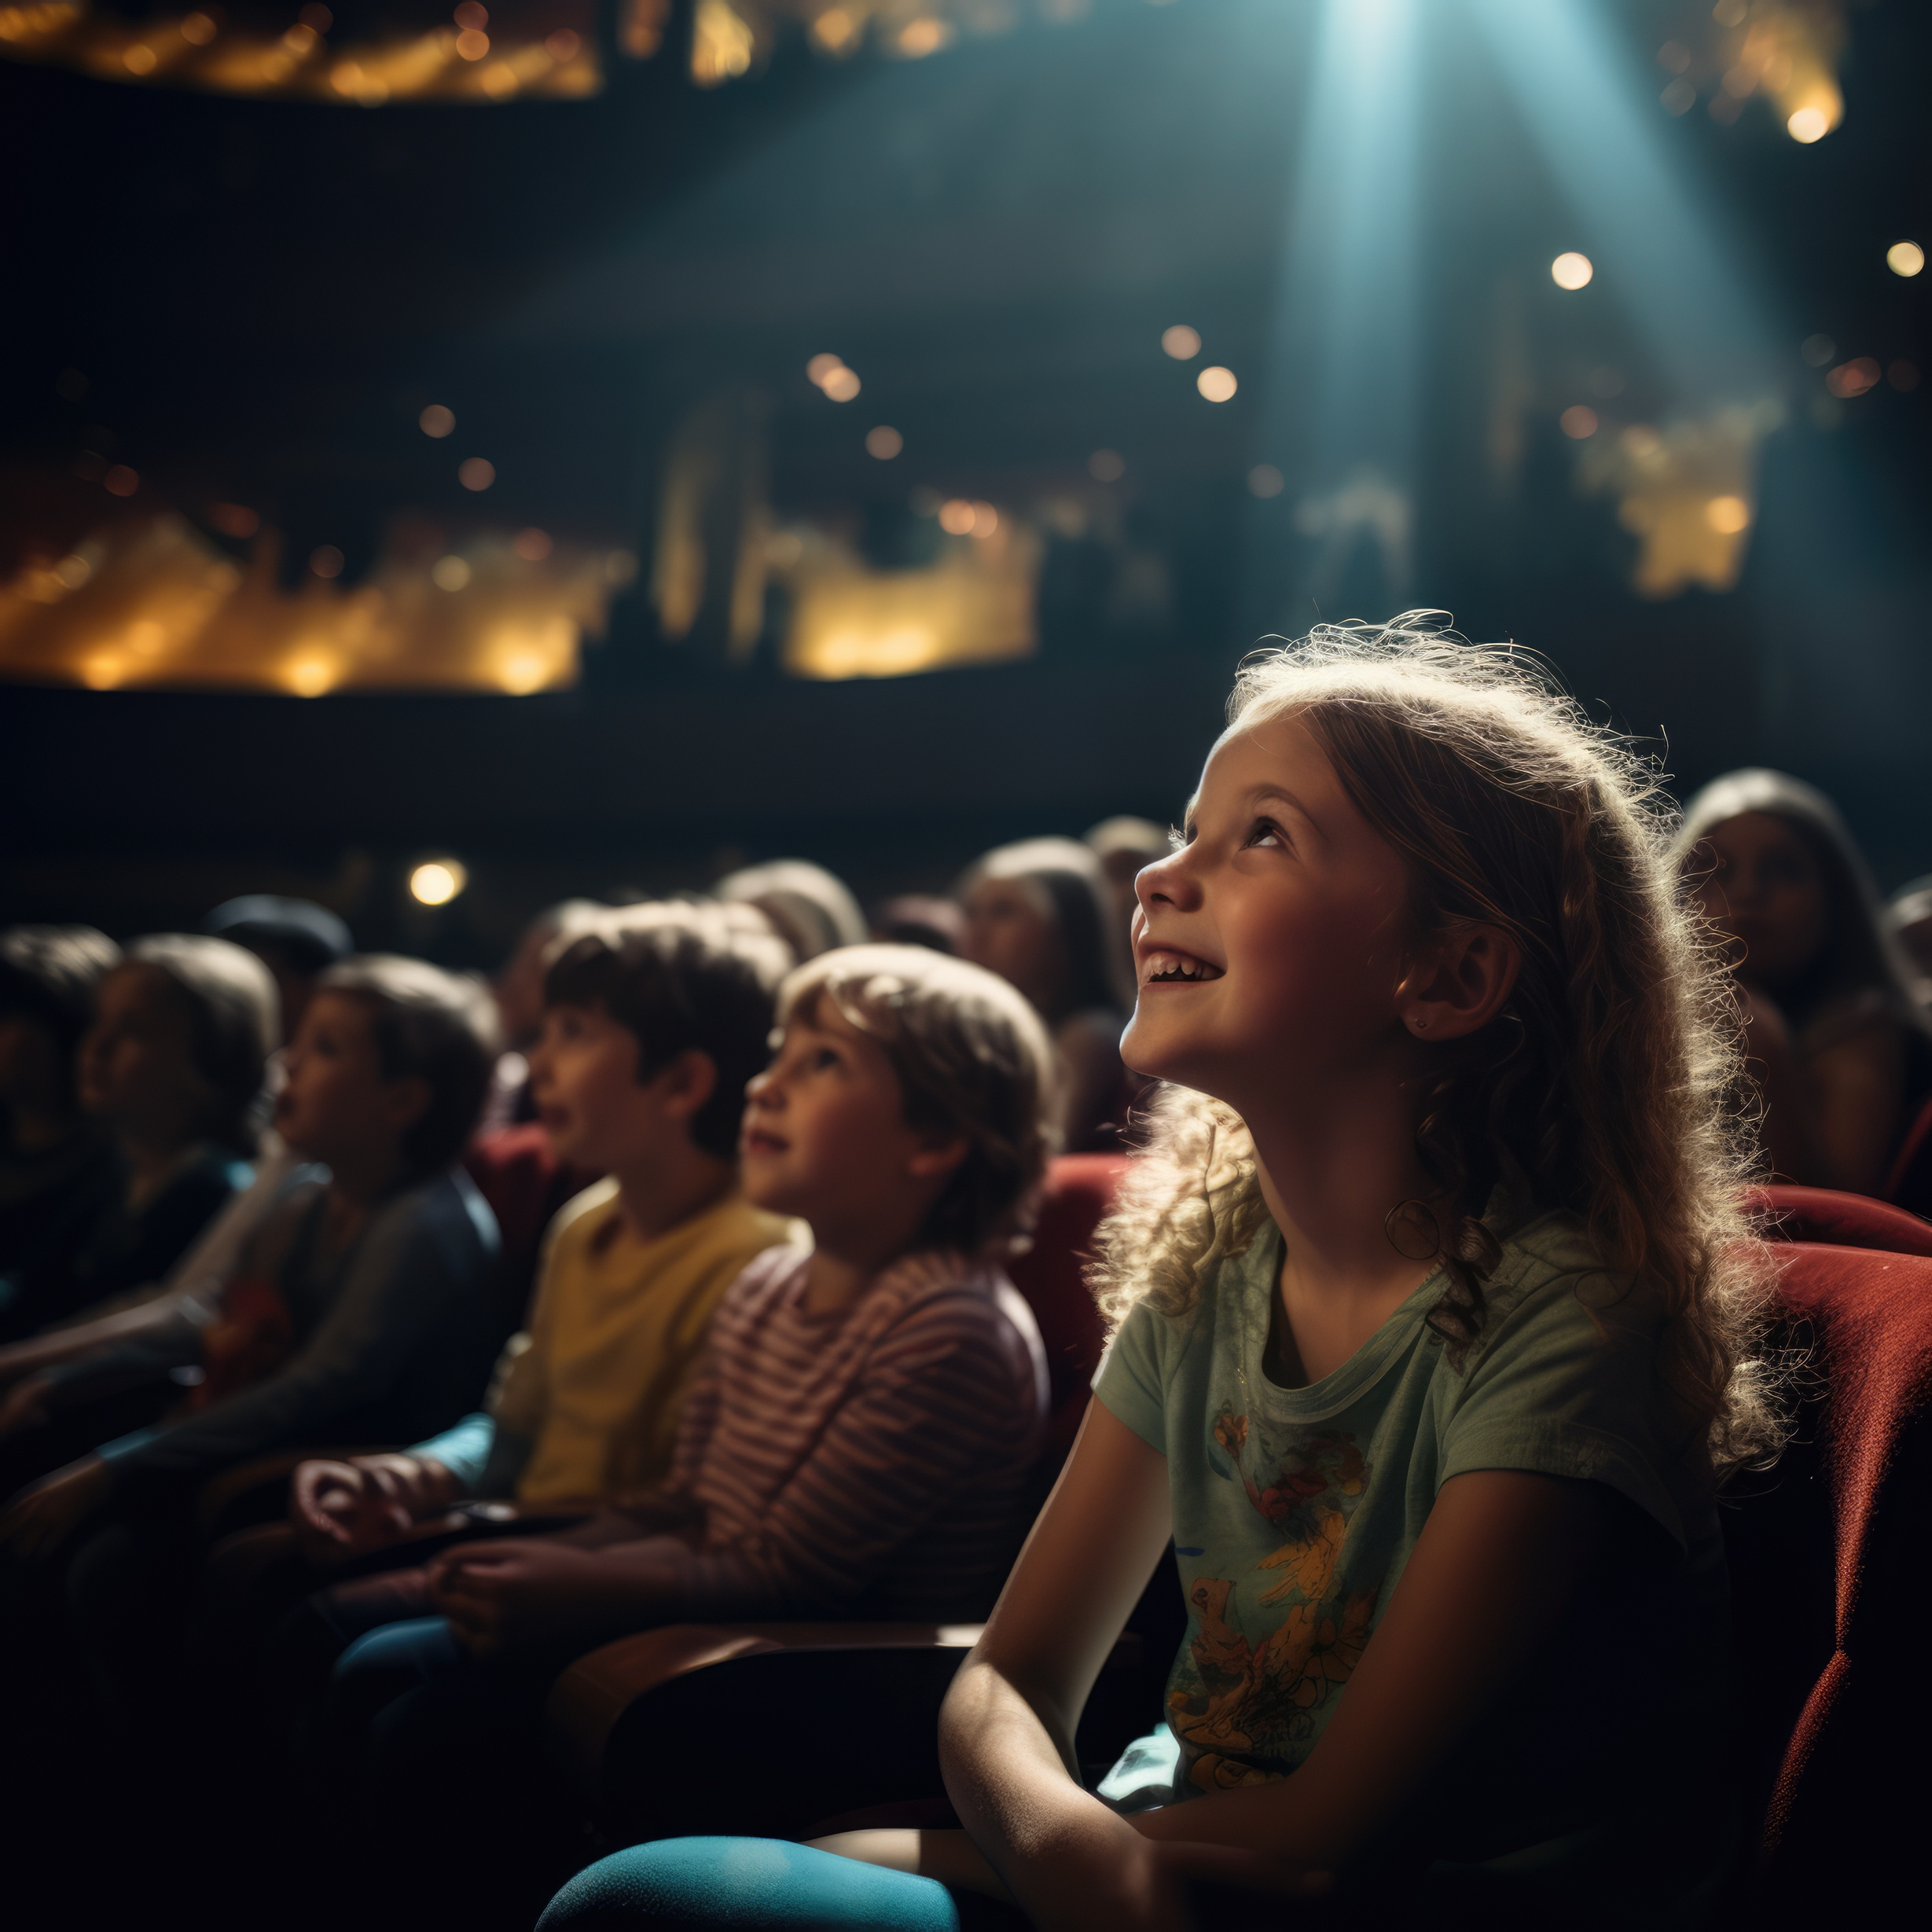
I will stay with my class and sit in my seat.
I can make sounds to show how I feel, like laughing or saying “wow”.
I will also be still and quiet so everyone can hear and see the show.
Image description: A group of children sit in a theatre. They are watching a show and having a good time.
9

Slide 14
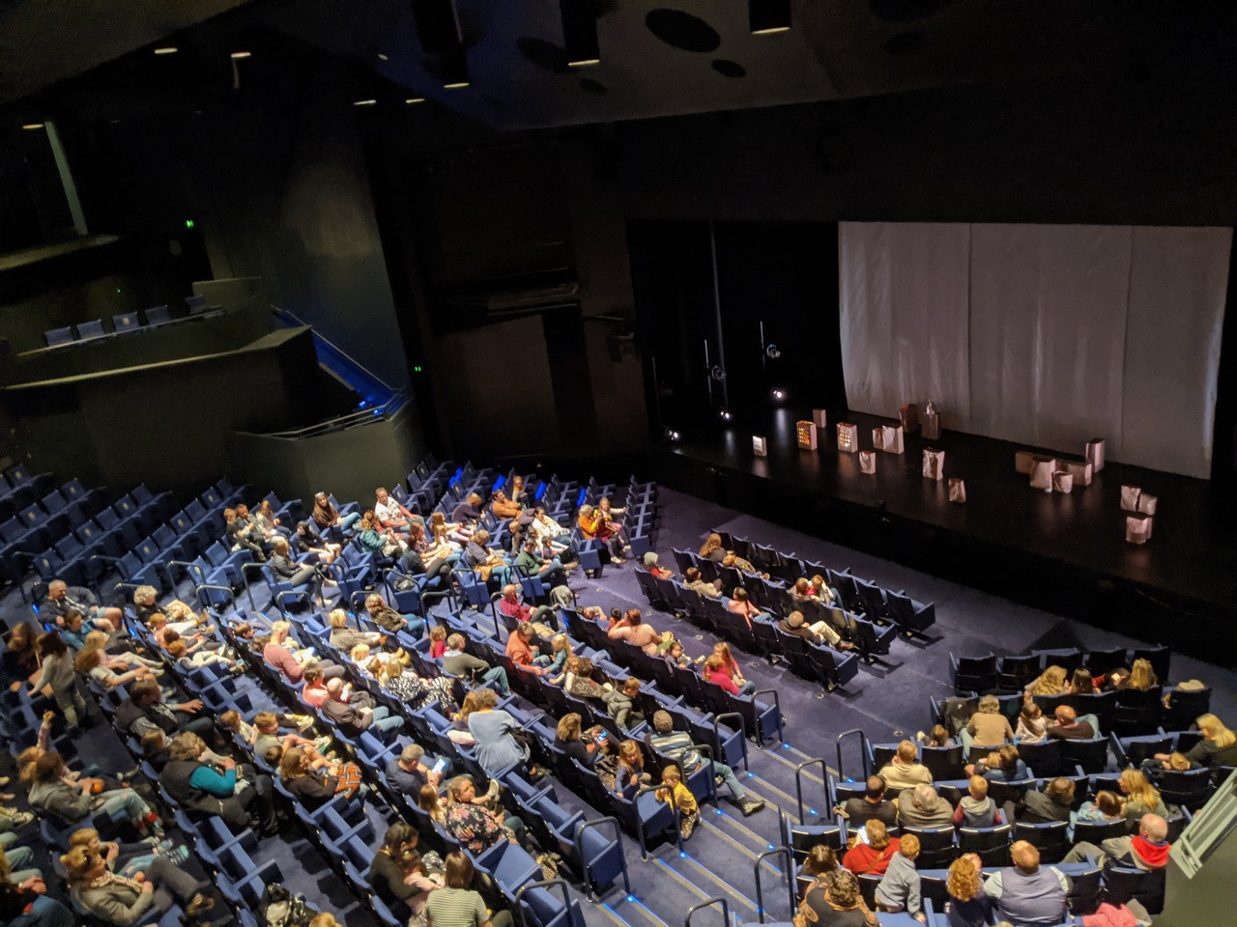
The show goes for 45 minutes.
If I need help, I can let an adult know.
An adult can assist me to leave the theatre during the show if needed.
Image description: A group of children sit in a theatre, they are waiting for a show to start. The stage is ready with a set and paper bags on the floor.
10

Slide 15
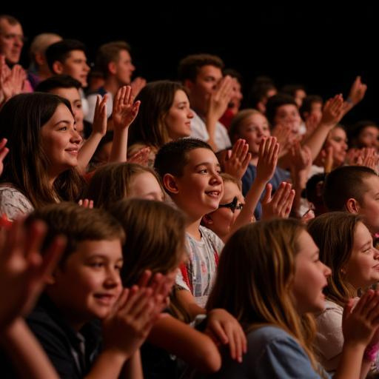
When the show finishes, people clap to say thank you.
Some people might even cheer!
I might feel happy, calm or even sad that it is ending. That is ok.
I can express my feelings in the way is comfortable for me.
Image description: A group of people in a theatre are laughing and clapping their hands.
11

Slide 16
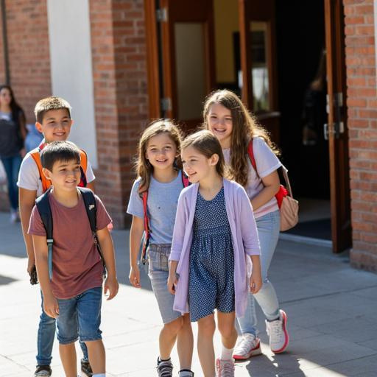
When we leave, I might:
talk about my favourite part
think about the shadows and light
tell my family about the story
Everyone experiences Me & My Shadow in their own way.
Image description: A group of children walk out of a theatre, they are smiling and talking.
12

Slide 17
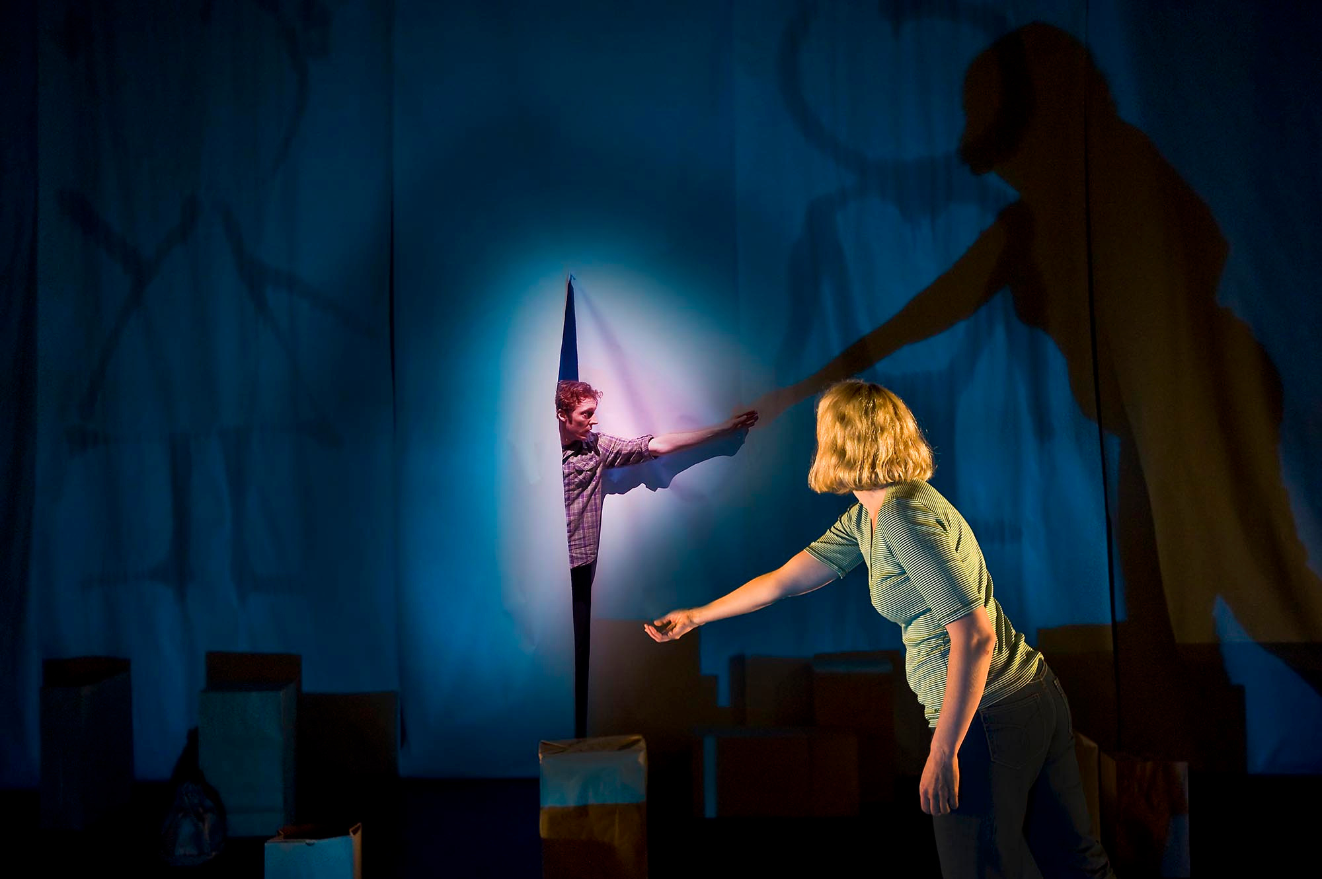
We are looking forward to seeing you at
Me & My Shadow!
Image description: A person reaches through a curtain and holds out his hand. In front of him, another person holds out her hand. Although they don’t touch, their shadows are holding hands.
13

